Slide 1

Encoding Algorithms
Anirudh KC (015231645)
Sumedh Kale ( )

Slide 2



Agenda
Introduction to Encoding Algorithms
Huffman Coding
LZW Coding
Arithmetic Encoding
Comparison

Slide 3
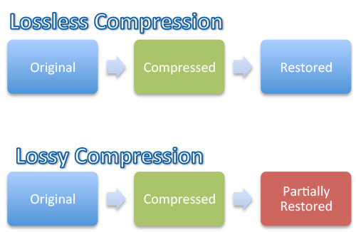
Introduction
Data compression algorithms enable encoding data such that long sequences of characters can be represented using fewer characters than its original representation.
These algorithms can be classified based on how effectively they are able to obtain the original message post compression.
There are 2 main groups:
Lossy algorithms
Lossless algorithms
Lossy algorithms discard unnecessary or redundant information while compressing such that the loss is minimal or undetectable, the space is therefore prioritized over accuracy.
Lossless algorithms on the other and make sure all the information can be retrieved after the compression decompression cycle.

Slide 4
Huffman Coding
Subtitle
Subtitle
Add text, images, art, and videos.
Add transitions, animations, and motion.
Save to OneDrive, to get to your presentations from your computer, tablet, or phone.
Open the Design Ideas pane for instant slide makeovers.
When we have design ideas, we’ll show them to you right there.

Slide 5
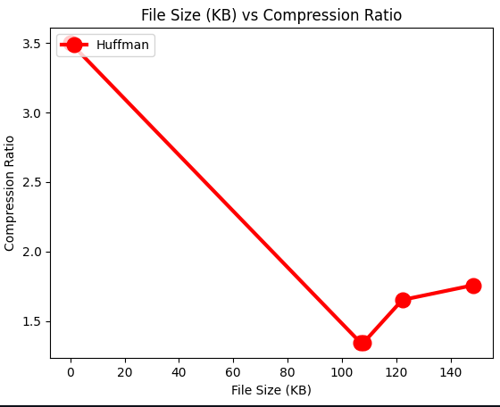
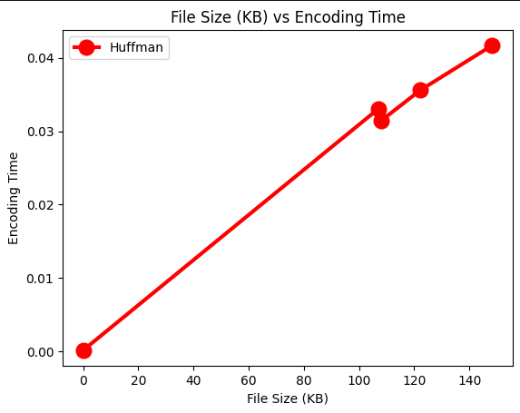
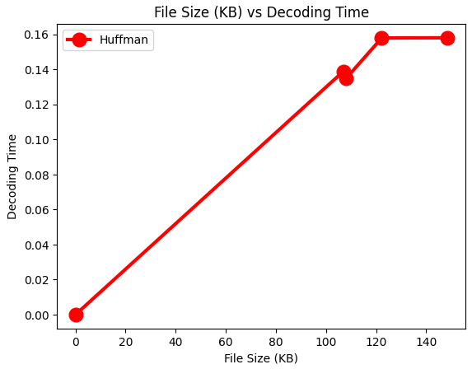
Performance Charts

Slide 6
LZW Coding
Subtitle
Subtitle
Add text, images, art, and videos.
Add transitions, animations, and motion.
Save to OneDrive, to get to your presentations from your computer, tablet, or phone.
Open the Design Ideas pane for instant slide makeovers.
When we have design ideas, we’ll show them to you right there.

Slide 7
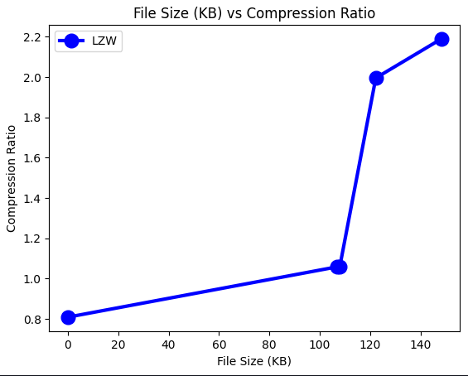
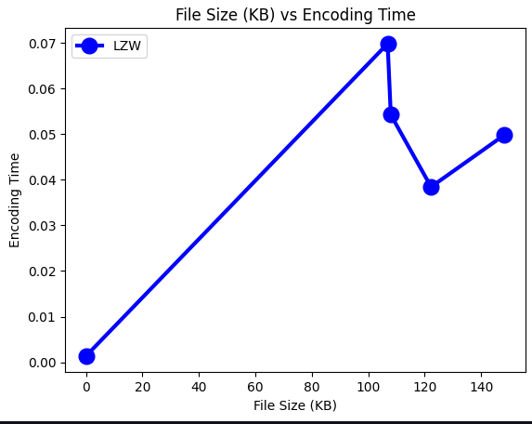
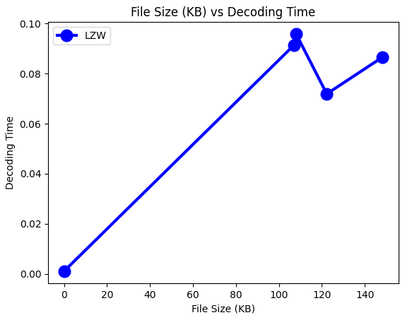
Performance Charts

Slide 8
Arithmetic Coding
Arithmetic Encoding is a lossless compression algorithm by employing a frequency table to encode the message into a decimal number.
Encoding works by representing the cumulative probabilities of all the symbols on a line between 0 and 1.
This is done based on the order of the characters in the message and the frequency of each character observed previously.
Decoding also requires the same frequency table along with the encoded message and the length of the message.

Slide 9
Working
Generate Frequency Table
Generate Probability table from frequency table
Encode:
Given any symbol C, it starts from the value S and ends at the value calculated using the following equation:
S+(P(C))*R
Where:
S: The cumulative sum of all previous probabilities.
P(C): The probability of symbol C.
R: The range of line which is calculated by subtracting the start from the end of the line.

Slide 10
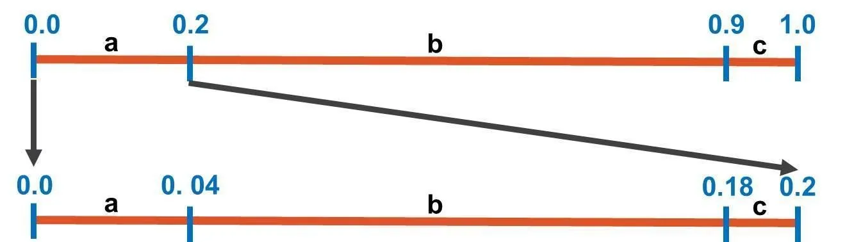
Example
Message to be encoded = “abc”
Encode: S+(P(C))*R
0.0 to 0.0+(0.2)*1.0=0.2 → (0.0 to 0.2)
0.2 to 0.2+(0.7)*1.0=0.9 → (0.2 to 0.9)
0.9 to 0.9+(0.1)*1.0=1.0 → (0.9 to 1.0)
Frequency table generated using previous messages (“babb“, “cbab” and “bb”)
Probability Table generated from frequency table (frequency(character) / sum of all frequencies)
Character | Frequency
a | 2
b | 7
c | 1
Encode “a”
0.0 to 0.0+(0.2)*0.2=0.04 → (0.0 to 0.04)
0.04 to 0.04+(0.7)*0.2=0.18 → (0.04 to 0.18)
0.18 to 0.18+(0.1)*0.2=0.2 → (0.18 to 0.2)
Character | Probability
a | 0.2
b | 0.7
c | 0.1
Notes:
Encoding in AE works by representing the cumulative probabilities of all symbols on a line that ranges from 0.0 to 1.0. On that line each symbol THEN uses a sub-range.

Slide 11
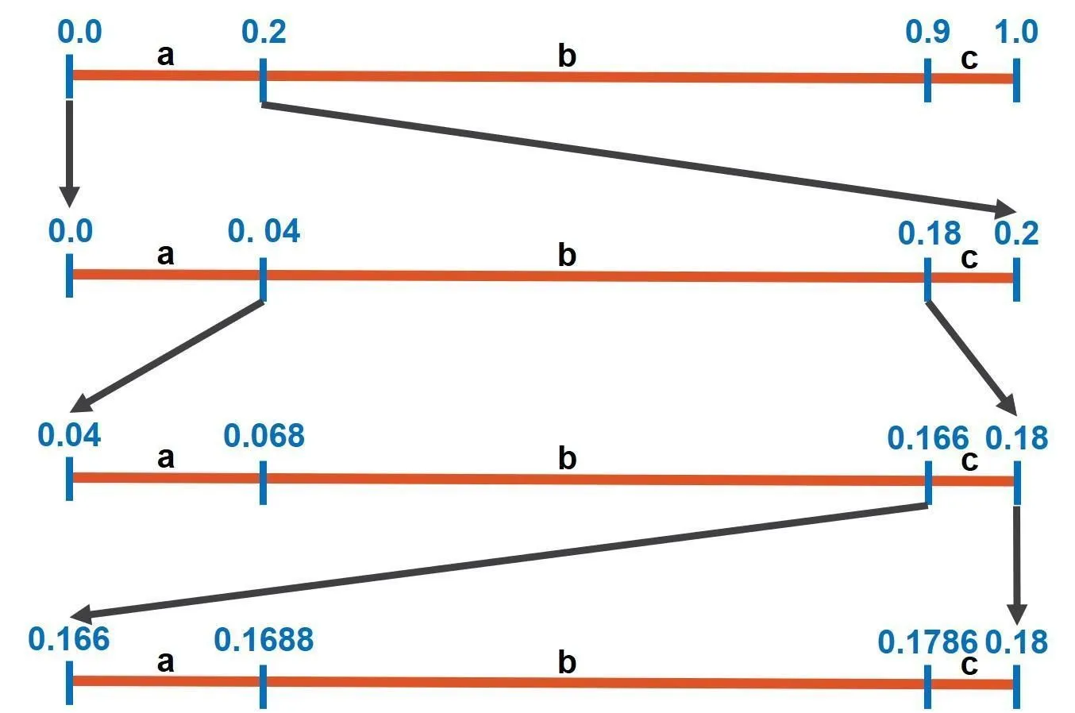
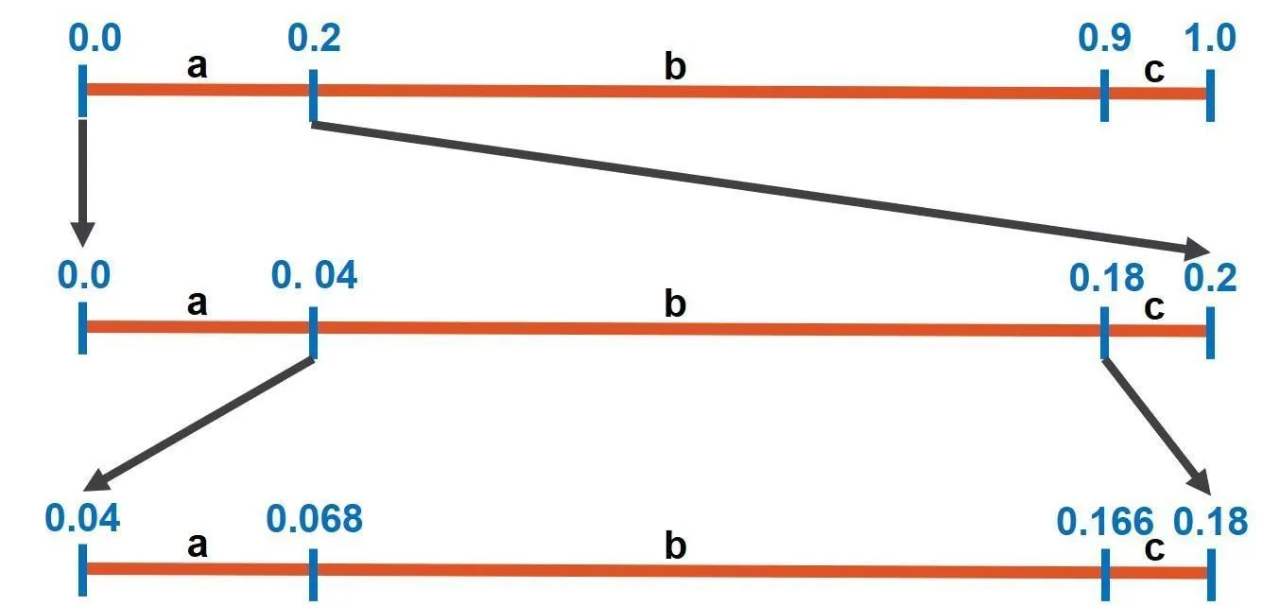
Encode
Encode “c”
0.166 to 0.166+(0.2)*0.014=0.1688 → (0.166 to 0.1688)
0.1688 to 0.1688+(0.7)*0.014 → (0.1688 to 0.1786)
0.1786 to 0.1786+(0.1)*0.014=0.18 → (0.1786 to 0.18)
Message to be encoded = “abc”
Encode “b”
0.04 to 0.04+(0.2)*0.14=0.068 → (0.04 to 0.068)
0.068 to 0.068+(0.7)*0.14=0.166 → (0.068 to 0.166)
0.166 to 0.166+(0.1)*0.14=0.18 → (0.166 to 0.18)
The latest interval reached by AE starts from 0.166 to 0.18. Any value in this range can be used to encode the message
(0.166+0.18) / 2 = 0.173

Slide 12
Decode
Draw a line from 0 to 1 and plot probabilities using same equation S+(P(C))*R
0.0 to 0.0+(0.2)*1.0=0.2 → (0.0 to 0.2)
0.2 to 0.2+(0.7)*1.0=0.9 → (0.2 to 0.9)
0.9 to 0.9+(0.1)*1.0=1.0 → (0.9 to 1.0)
Inputs:
Encoded Value = 0.173
Number of symbols = 3
Frequency Table
Character | Frequency
a | 2
b | 7
c | 1
0.173 falls within the first interval (0.0 to 0.2).
The first symbol in the decoded message is therefore ‘a’
Next symbol is within (0.0 to 0.2)
0.0 to 0.0+(0.2)*0.2=0.04 → (0.0 to 0.04)
0.04 to 0.04+(0.7)*0.2=0.18 → (0.04 to 0.18)
0.18 to 0.18+(0.1)*0.2=0.2 → (0.18 to 0.2)
Probability Table generated from frequency table
Character | Probability
a | 0.2
b | 0.7
c | 0.1

Slide 13
Decode
0.173 falls within the second interval (0.04 to 0.18).
The second symbol in the message is therefore ‘b’
Next symbol will be within (0.04 to 0.18)
0.04 to 0.04+(0.2)*0.14=0.068 → (0.04 to 0.068)
0.068 to 0.068+(0.7)*0.14=0.166 → (0.068 to 0.166)
0.166 to 0.166+(0.1)*0.14=0.18 → (0.166 to 0.18)
0.173 falls within the third interval (0.166 to 0.18).
The third symbol in the message is therefore ‘c’
The given length was 3 and we have found 3 symbols so we stop
Decoded Message = “abc”

Slide 14
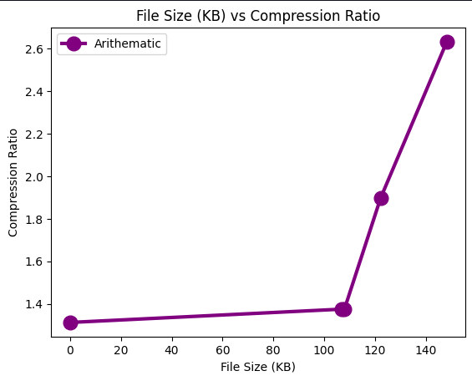
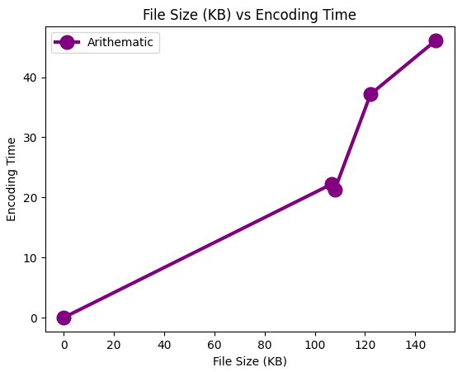
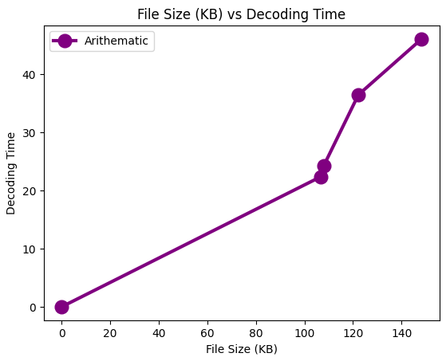
Performance Charts

Slide 15
Remarks
Arithmetic Encoding produces a high compression ratio at the cost of computational resources.
The precision required to store large messages is high and the resulting computations can be resource intensive.
It is therefore not recommended for streams of data.
Images require a large number of bits to define colors, arithmetic encoding allows compressing images while preserving the bits per pixel (bpp).
It is therefore used in deep learning to compress images while maintaining high quality
Notes:
the total number of bits required to code the color information of the pixel

Slide 16
Applications of the encoding algorithms
Uses of Huffman encoding includes conjunction with cryptography and data compression. Huffman Coding is applied in compression algorithms like DEFLATE (used in PKZIP), JPEG, and MP3
LZW is also used in the DEFLATE compression algorithm along with Huffman coding. Global Navigation Satellite System (GNSS) simulation task also uses a version of LZW as the preservation and transmission of these data are a complex and time-consuming work
Arithmetic encoding is used in compression algorithms like bzip and to encode JPEG files similar to Huffman. Image compression using AE is also used in deep learning models to preserve image quality after compression.

Slide 17

Comparison

Slide 18
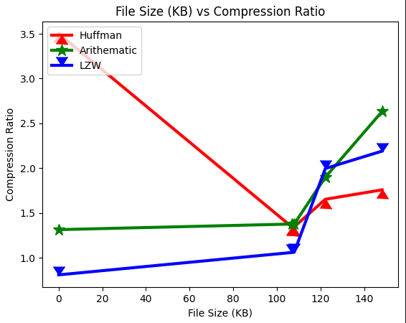
Huffman v Arithmetic v LZW Algorithms
Compression Ratio

Slide 19
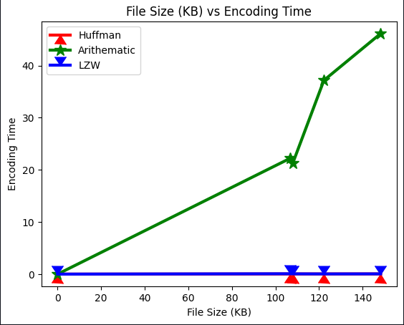
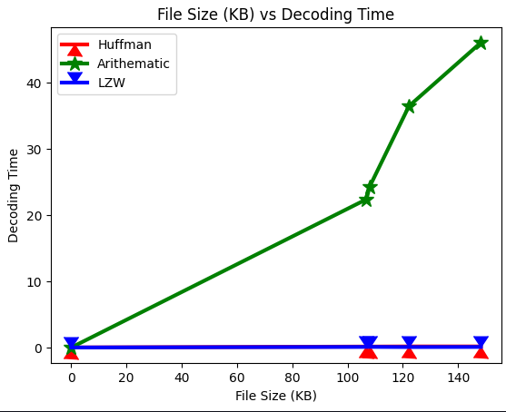
Huffman v Arithmetic v LZW Algorithms
Encoding/Decoding Times

Slide 20
DEMO

Slide 21
Thank You

